Slide 1


Department of Information Technology IT 244: Software Group Project I SOLAR SYSTEM
Prepared by:
Kashyap Nirmal - 16IT059 | Akshay Pandya - 16IT061
Guided by:
Ms. Ayesha Shaikh
Year: 2017

Slide 2
Outlines
Project Summary
Introduction
Work Accomplished
Future Targets
Reference

Slide 3

Project Summary
The idea behind the project is to develop a C++ program of animation, which displays the model of our Solar System(i.e. on the basis of Kepler’s Law).
This model will assist us to visualize the planetary motions in our Solar System. The real life statistics are also displayed.
Here basically we are using graphics.h . As it is a traditional library it may not be found in many latest versions of IDE’s. So we have downloaded and included it.

Slide 4
What is SOLAR SYSTEM ?
The Solar System is the Sun and celestial objects that orbit around it.
The planets are the biggest celestial bodies.
We do have the collection of eight planets and their moons . Alongside there are smaller bodies in the form of asteroids, meteoroids, and comets.
These eight planets in the Solar System from closest to farthest from the Sun, are: Mercury, Venus, Earth, Mars, Jupiter, Saturn, Uranus and Neptune.
Pluto is considered as a dwarf planet.

Slide 5
The Solar Systems follows different theories which are likely Heliocentric (i.e. the Sun as the centre) , Geocentric (i.e. the Earth as the centre) and many more.
One of the theory among them is Kepler’s law.
In astronomy, Kepler's Laws Of Planetary Motions are three scientific laws describing the motion of planets around the Sun.
The first among them states :
“The orbit of a planet is an ellipse with the Sun at one of the two foci.”

Slide 6
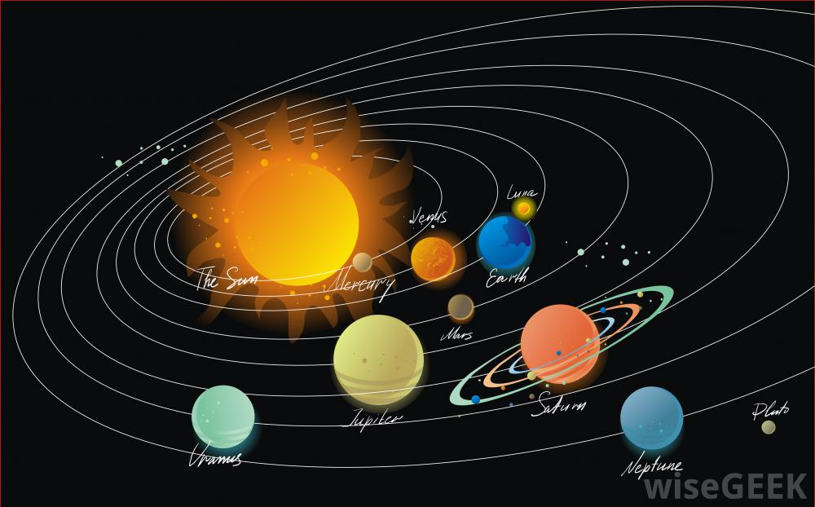
Solar System

Slide 7
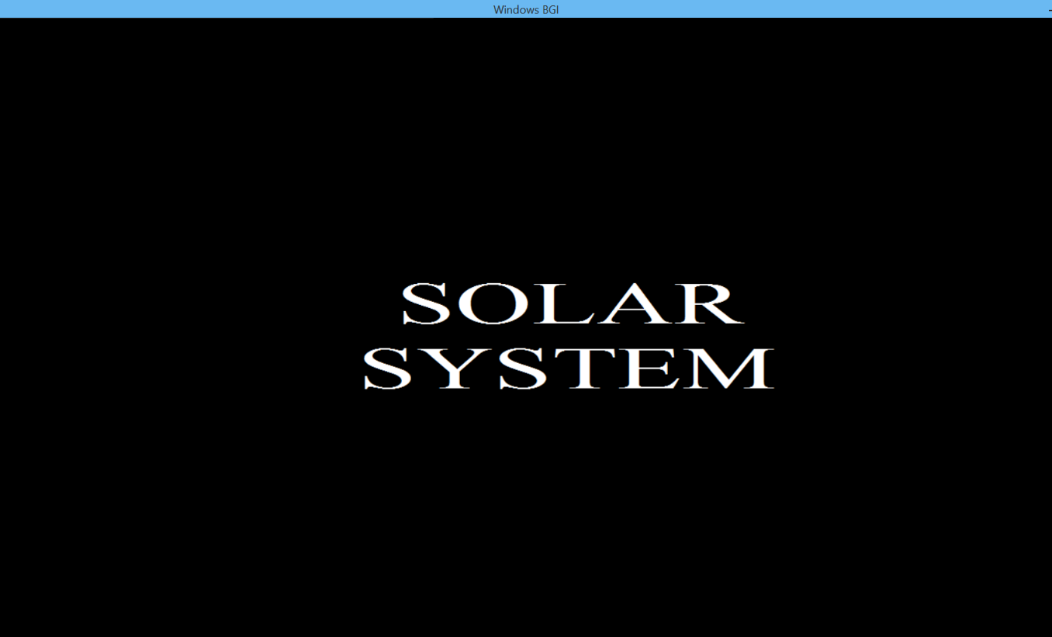
Work Accomplished
Welcoming Screen : It is the first page of the application.

Slide 8
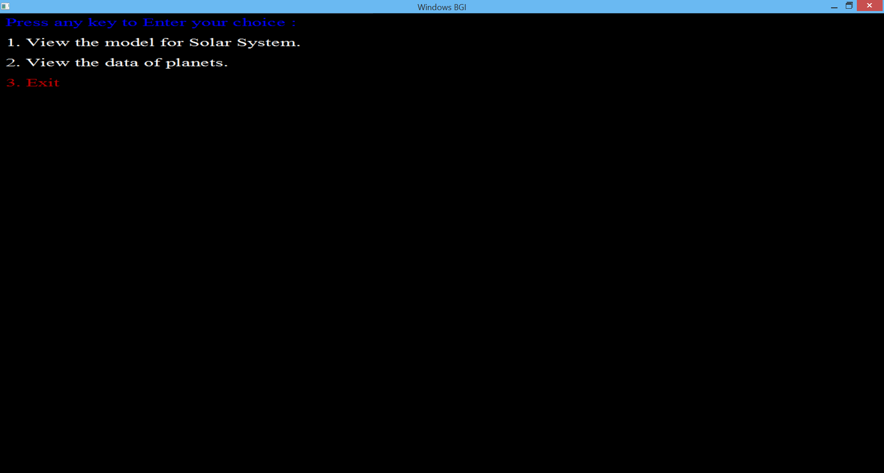
Menu Driven Options: The second screen gives the user a menu of the application.

Slide 9
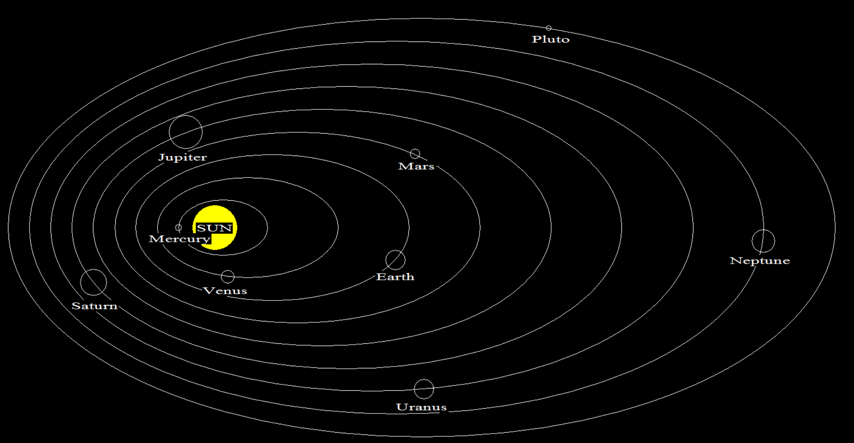
Solar System Model: For choice 1,the output screen which displays the solar system .

Slide 10
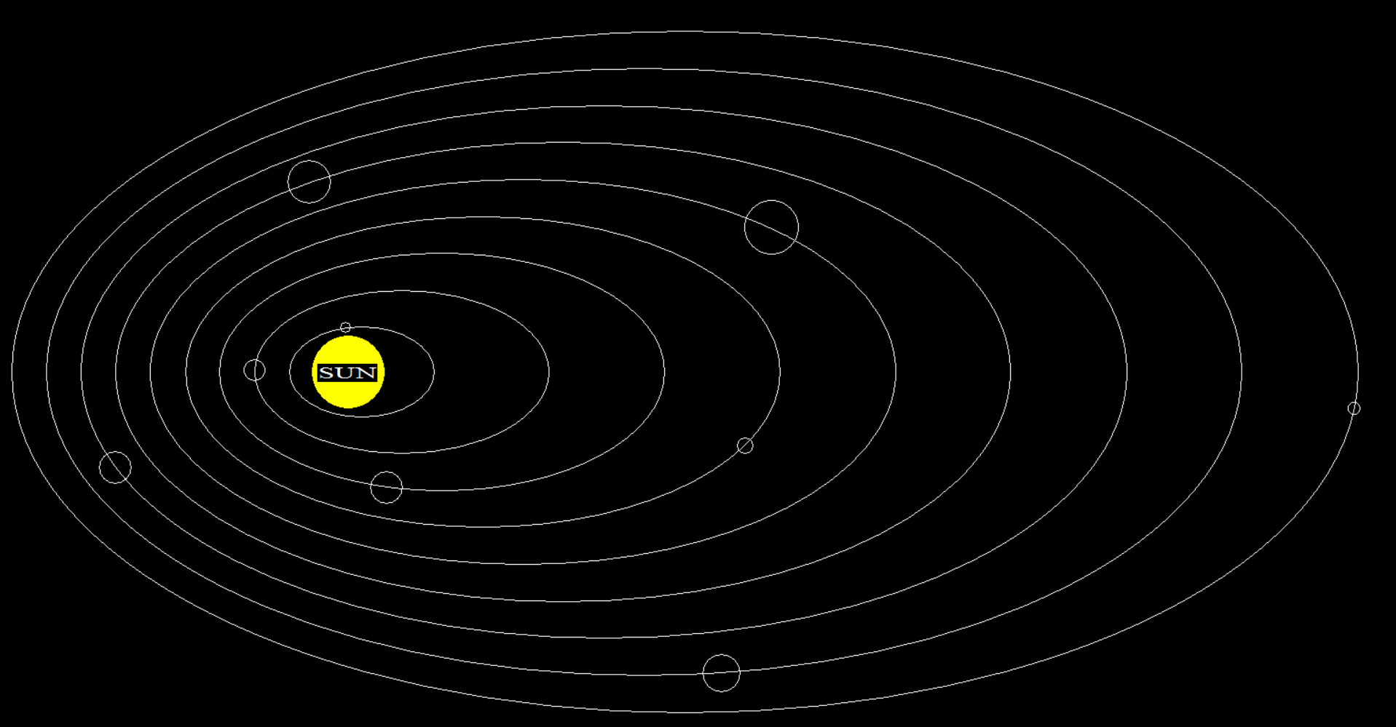

Slide 11
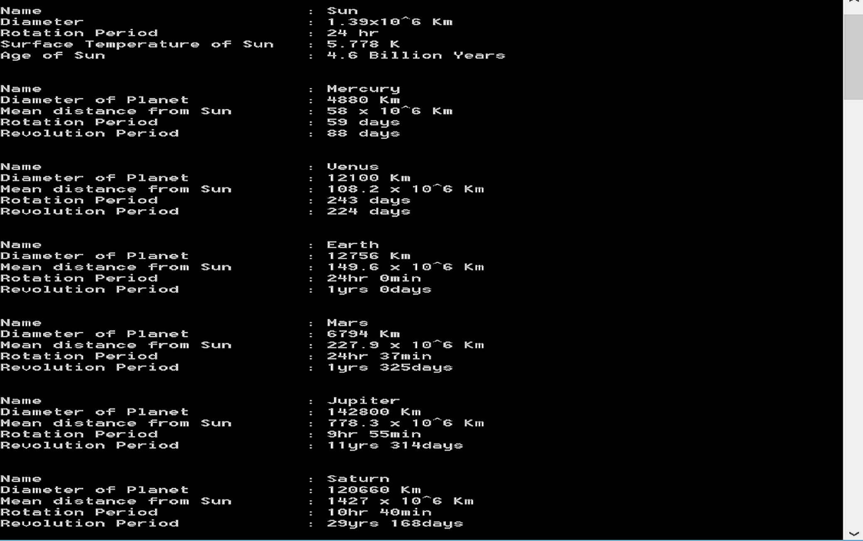

Slide 12
Future Targets
In future, we would like to add graphical user interface and attracting features which are different from these used.
We would like to use mouse event for this project with new and some exciting animation effects.

Slide 13
References:
www.cs.colorado.edu/~main/bgi/winbgim.h (version 3.4)
www.cs.colorado.edu/~main/bgi
Image:-m.wisegeek.com/what-is-the-history-of-the-solar-system.htm
Turbo C++ help menu.

Slide 14
Thank You….

